Slide 1

Shield Insurance
Presented By Mayukh Bose

Slide 2
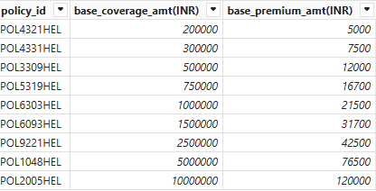
Shield Insurance provides a total of 9 policies

Slide 3
Sales Mode
Online
Offline
Online Website
Offline Agent
Online App
Offline Direct

Slide 4
Cities
Delhi NCR
Chennai
Indore
Hyderabad
Mumbai

Slide 5
Dataset
Dim_customer
Dim_policies
Dim_date
Fact_premium
Fact_settlement
Data was available from Nov 2022 till April 2023

Slide 6
Let’s Explore
The Dashboard

Slide 7
Thank you for watching!

